Slide 1
BCOG 100
Brains and Reinforcement Learning
Lecture 3: The Implementational Level

Slide 2
Reading Check 6-2
Password: critic
Question: Is social learning (learning from other people) classical or operant conditioning? Defend your answer.

Slide 3
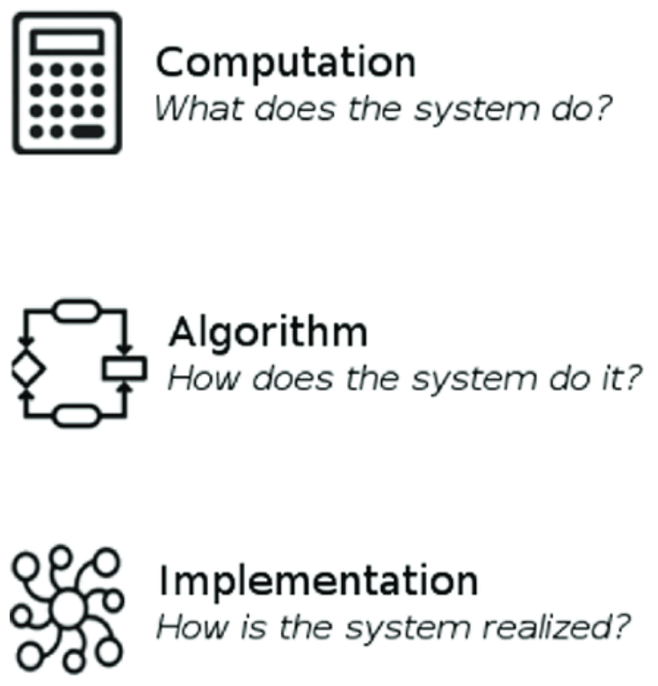
Implementing Reinforcement Learning in Brains
Recap & Overview
Error-driven learning, TD, actor–critic
Today:
How the brain implements RL
Focus: dopamine and basal ganglia circuit
Notes:
Last time we explored reinforcement learning at the algorithmic level.
We saw how error-driven rules like the delta rule and temporal difference learning solve the credit assignment problem.
We looked at the actor–critic model, where one system evaluates states and another system chooses actions,
linked together by prediction error.
Today we shift to the implementational level — how the brain actually carries out reinforcement learning.
We’ll ask: where do prediction error signals come from in the brain?
Which circuits implement the actor and critic roles?
And how does reinforcement learning emerge from real neurons, neurotransmitters, and synapses?
We’ll focus especially on dopamine and the basal ganglia.
Dopamine neurons turn out to carry a prediction error signal that looks remarkably like the ones in our algorithmic models.
And basal ganglia loops provide the structure for action selection, habit formation, and goal-directed learning.
By the end of this lecture, we’ll see how reinforcement learning is not just a computational idea,
but a biological process deeply rooted in the vertebrate brain.
To orient ourselves, let’s return briefly to David Marr’s three levels of analysis.
This framework has been guiding the way we’ve been thinking about reinforcement learning across our lectures.
At the computational level, we asked: what is the problem reinforcement learning solves?
And the answer was: connecting actions to delayed outcomes, solving the credit assignment problem.
At the algorithmic level, we asked: what rules or processes could solve this problem?
That’s where we introduced error-driven learning, temporal difference updates, and the actor–critic model.
Now, at the implementational level, we ask: how does the brain do this in practice?
What neurons, neurotransmitters, and circuits embody these rules?
And how did evolution shape these systems to support reinforcement learning?
That’s the focus of today’s lecture.

Slide 4
Implementing Reinforcement Learning in Brains
Evolutionary Roots of Neuromodulators
Classical: glutamate & GABA (synaptic signals)
Neuromodulators: dopamine, serotonin, norepinephrine (state control)
Together shaped primitive valence & arousal
 |  | Arousal
 |  | High | Low
Valence | Good | Excited | Content
 | Bad | Anxious | Depressed
Notes:
As we move into reinforcement learning in the brain,
it’s worth stepping back to recall the evolutionary roots of neurotransmission.
Early animals already had two broad categories of chemical messengers.
The first are the classical transmitters, glutamate and GABA.
These operate at point-to-point synapses and control whether a neuron is more or less likely to fire.
That’s what we mean by “excitatory” and “inhibitory” at the cellular level.
The second group are the neuromodulators: dopamine, serotonin, and norepinephrine.
Mechanistically, they also excite or inhibit neurons, depending on the receptor subtype.
But functionally, their impact is different.
Because they act through slower, more diffuse pathways,
they shift the state of whole circuits rather than carrying precise, moment-to-moment messages.
This means they bias the organism behavior in more general ways,
such as toward high or low arousal, approach or avoidance, exploration or quiescence.
Together, these systems gave early animals a primitive affective architecture.
Valence told them whether something was good or bad.
Arousal told them whether to act energetically or stay quiet.
These dimensions, supported by neuromodulators, are the evolutionary backdrop for the later emergence of reinforcement learning.

Slide 5
Implementing Reinforcement Learning in Brains
 |  | Arousal
 |  | High | Low
Valence | Good | Excited | Content
 | Bad | Anxious | Depressed
Dopamine Before RL
Ancient neuromodulator in invertebrates
Tunes arousal, movement, motivation
Effect depends on context and circuit
Notes:
Dopamine is an ancient neuromodulator, present across bilaterians and used by invertebrates like worms, flies, and crustaceans.
In these early animals, dopamine’s job was not to carry prediction errors.
Instead, it acted as a regulator of arousal, locomotion, and motivational tone.
For example, in C. elegans, dopamine release when the worm touches a solid surface suppresses swimming and promotes crawling.
In insects, dopamine can energize activity, promote arousal, or support learning about rewards and punishments.
Mechanistically, dopamine receptors can either excite or inhibit neurons.
Functionally, this means dopamine can push the organism in different directions depending on context
— sometimes ramping up activity, sometimes suppressing it,
sometimes biasing toward approach, sometimes toward withdrawal.
So dopamine’s early role was to tune the state of behavior, not to encode teaching signals.
That innovation came later, with the “grand repurposing” in vertebrate brains.

Slide 6
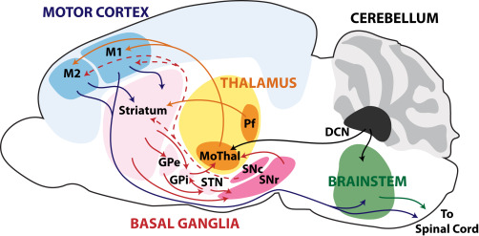
Implementing Reinforcement Learning in Brains
The Evolutionary Repurposing of Dopamine
Basal ganglia: global action gate
Default: inhibit all actions until released
Dopamine repurposed into teaching signals
Notes:
In early vertebrates, dopamine was woven into new brain circuits: the basal ganglia.
The basal ganglia have a distinctive architecture.
They are massively connected to motor areas, and their default job is to keep actions from happening.
They do this by tonically inhibiting motor outputs, holding all possible actions in check.
Only when the right signals arrive does the basal ganglia disinhibit one pathway, allowing a particular action to occur.
This gating function was already in place before reinforcement learning was layered on top.
It provided a natural mechanism for selecting one action from many possibilities.
The “grand repurposing” was that dopamine neurons began feeding into this system ,
not just as modulators of arousal or movement, but as teaching signals.
Bursts of dopamine could bias the gate toward the actions that led to better-than-expected outcomes,
while dips could reinforce suppression of actions that turned out worse.
So the basal ganglia’s pre-existing role as an action gate made it the perfect circuit to integrate dopamine’s new function as a prediction error signal.
Together, they formed the core of reinforcement learning in vertebrate brains.

Slide 7
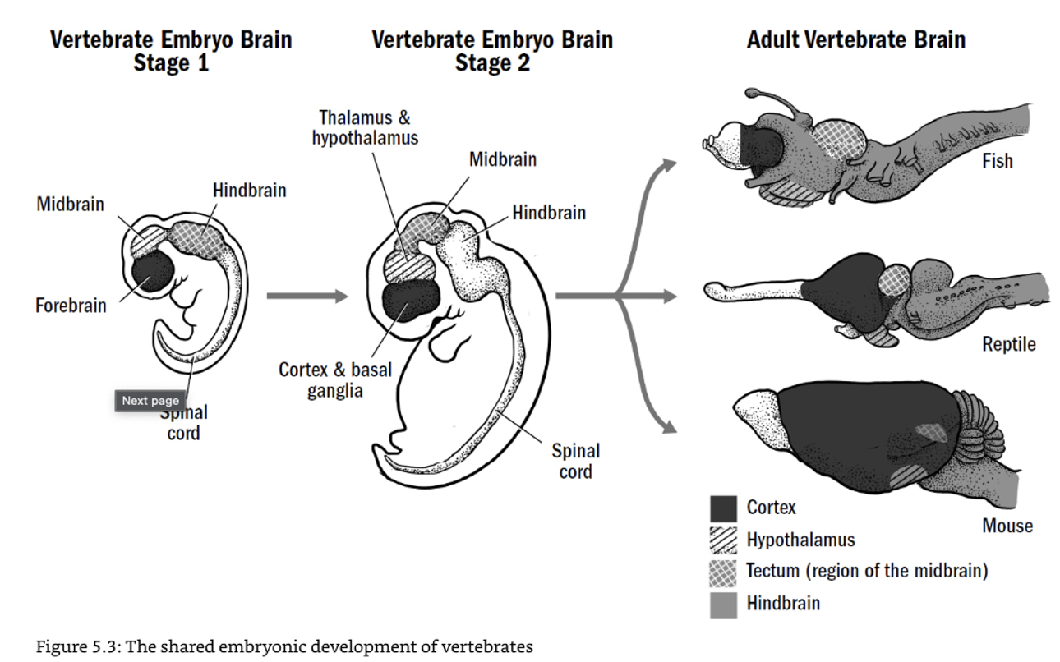
Implementing Reinforcement Learning in Brains
Brains Built for Reinforcement Learning
Basal ganglia conserved across vertebrates
Cortex → striatum → pallidum → thalamus → cortex
Action gating + dopamine teaching = RL engine
Notes:
The basal ganglia are among the most conserved structures in all vertebrates.
We find the same basic circuit in fish, amphibians, reptiles, birds, and mammals.
The loop looks like this:
Signals flow from the cortex into the striatum.
From there, they pass through nuclei like the globus pallidus and substantia nigra,
then on to the thalamus, and finally back to the cortex.
It’s a tightly organized feedback system.
As we just said, the basal ganglia’s baseline function is to gate actions.
By default, they inhibit all motor outputs.
But when the right inputs arrive, they release the brake on one pathway, allowing a particular action to go forward.
Now add dopamine into the picture.
Dopamine projections from the midbrain pour into the striatum, right where this gating occurs.
Suddenly the system doesn’t just release actions randomly — it can bias the gate based on prediction errors.
Actions that lead to better-than-expected outcomes are more likely to be released in the future.
Actions that lead to worse outcomes are more likely to stay suppressed.
In this way, the basal ganglia’s ancient gating mechanism,
combined with dopamine teaching signals,
becomes a powerful reinforcement learning engine at the core of the vertebrate brain.

Slide 8
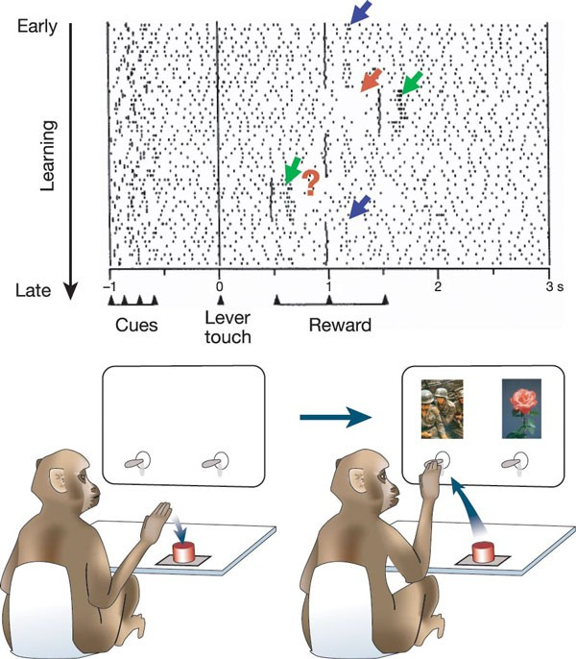
Implementing Reinforcement Learning in Brains
Dopamine: First Clues
Schultz’s monkey experiments (1990s)
Unexpected reward → dopamine burst
With training, response shifts to cue
Reward omitted → dopamine dip
Notes:
The first strong evidence that dopamine was acting as a teaching signal came from
Wolfram Schultz’s experiments with monkeys in the 1990s.
He recorded from dopamine neurons in the midbrain while monkeys performed a simple task.
At first, when juice was delivered unexpectedly, dopamine neurons fired a strong burst.
This was the classic “better than expected” signal.
But after training, something changed.
The dopamine burst shifted earlier in time — away from the reward itself, and onto the cue that predicted the reward.
The juice was no longer surprising, so it no longer produced a dopamine burst.
And when the monkeys expected juice but it didn’t arrive, dopamine activity dipped below baseline.
This was a “worse than expected” signal.
Taken together, these patterns look exactly like a temporal difference prediction error:
Better than expected → burst
As expected → no change
Worse than expected → dip
This was the first clear physiological evidence that dopamine neurons
are encoding the same kind of error signal we modeled at the algorithmic level.

Slide 9
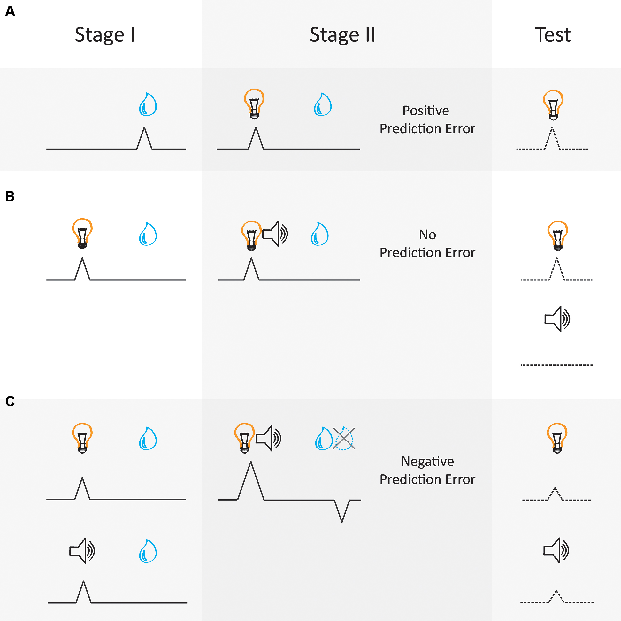
Implementing Reinforcement Learning in Brains
Dopamine as Prediction Error
Phasic firing matches TD learning rules
Shifts from reward to predictive cue
Blocking and over-expectation also follow error laws
Notes:
Schultz and colleagues showed that dopamine neurons behave,
exactly as the prediction error rules would predict.
In simple Pavlovian conditioning, dopamine neurons fire strongly
when a reward is delivered unexpectedly.
But with repeated cue–reward pairings, that burst of activity shifts earlier in time
— from the reward itself to the cue that predicts it.
At the time of reward, there is no burst, because there is no longer any prediction error.
In blocking, if a reward is already fully predicted by one cue,
adding a new cue produces no dopamine response.
Because there is no prediction error, no learning accrues to the new cue.
And in over-expectation, when two cues are each trained separately to predict a reward,
then presented together, the combined expectation is greater than what is delivered.
That produces a negative prediction error
— dopamine firing dips below baseline at the time of reward,
and associative strength decreases.
So dopamine neurons don’t just respond to reward.
They follow the exact mathematical rules of prediction error
as formalized in Sutton and Barto’s reinforcement learning model.

Slide 10
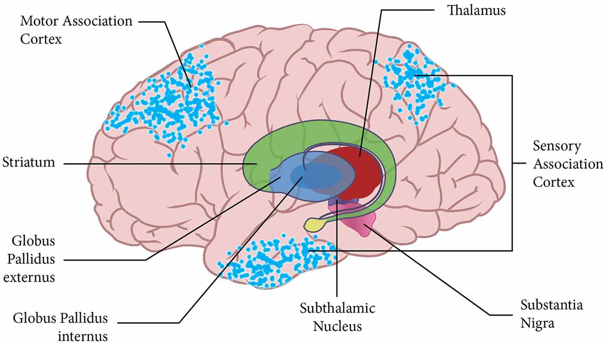
Implementing Reinforcement Learning in Brains
Basal Ganglia Anatomy
Input hub: striatum
Output nuclei: globus pallidus, substantia nigra
Loop: cortex → striatum → pallidum → thalamus → cortex
Notes:
Now let’s zoom in on the basal ganglia to see how dopamine signals get implemented.
The striatum is the main input hub.
It receives massive inputs from the cortex and from dopamine neurons in the midbrain.
From the striatum, signals flow into the output nuclei — the globus pallidus and substantia nigra pars reticulata.
These nuclei project to the thalamus, which sends signals back up to the cortex.
This creates a tightly organized feedback loop:
cortex → striatum → pallidum/nigra → thalamus → back to cortex.
By default, the output nuclei are firing tonically, keeping motor commands suppressed.
But activity in the striatum, modulated by dopamine, can disinhibit selected pathways, allowing a chosen action to go forward.
So the basal ganglia don’t directly generate movement.
Instead, they serve as a selection and gating system, deciding which actions get released at any given time.
This is the circuit where dopamine prediction errors do their work,
strengthening or weakening the pathways that led to better or worse outcomes.

Slide 11
Implementing Reinforcement Learning in Brains
Actor–Critic in the Brain
Ventral striatum ≈ critic (value predictions)
Dorsal striatum ≈ actor (action choices)
Dopamine TD errors update both
Notes:
The actor–critic model we discussed last time has a striking parallel in the anatomy of the basal ganglia.
The ventral striatum, which includes the nucleus accumbens, is especially tied to predicting the value of states.
It integrates cues and contexts to estimate how good the current situation is.
This makes it a natural fit for the role of the critic.
The dorsal striatum is more closely linked to motor and action systems.
It helps decide which action to perform and how strongly to bias toward it.
This makes it a natural fit for the actor.
Dopamine neurons in the midbrain broadcast prediction error signals to both ventral and dorsal striatum.
That means the same temporal difference error can update the critic’s value predictions and the actor’s action tendencies at the same time.
So in the brain, the actor–critic model isn’t just an abstraction.
It maps neatly onto actual structures, with the ventral striatum serving as critic,
the dorsal striatum as actor, and dopamine as the teaching signal linking them together.

Slide 12
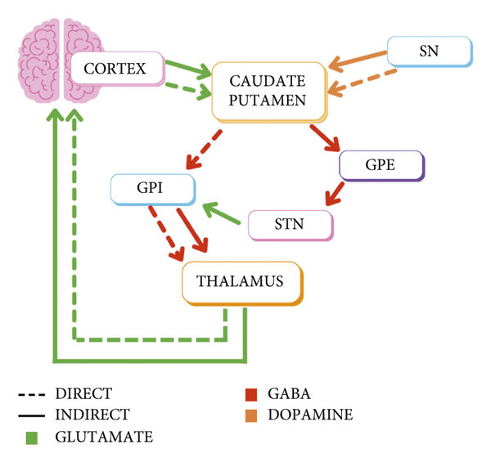
Implementing Reinforcement Learning in Brains
Direct and Indirect Pathways
D1 receptors: direct “Go” pathway → promote action
D2 receptors: indirect “No-Go” pathway → suppress action
Dopamine shifts balance between Go and No-Go
Notes:
Within the basal ganglia, dopamine acts on two major pathways through the striatum.
These are called the direct and indirect pathways, and they have opposite effects on action.
The direct pathway, sometimes called the “Go” pathway, is dominated by neurons with D1 dopamine receptors.
When dopamine binds to D1 receptors, it makes these neurons more active.
The result is to release the brake on an action, making it more likely to be performed.
The indirect pathway, sometimes called the “No-Go” pathway, is dominated by neurons with D2 receptors.
When dopamine binds here, it tends to reduce their activity.
That weakens the suppression signal, again making actions more likely.
If dopamine dips, the opposite happens: D2 neurons become more effective, strengthening suppression of actions.
So in simple terms, dopamine bursts tip the balance toward Go, promoting action.
Dopamine dips tip the balance toward No-Go, suppressing action.
This push–pull mechanism lets dopamine act as a flexible teaching signal.
Bursts reinforce actions that led to better outcomes.
Dips strengthen suppression of actions that led to worse outcomes.

Slide 13
Implementing Reinforcement Learning in Brains
Learning Mechanism
Dopamine bursts → strengthen “Go” synapses (D1)
Dopamine dips → strengthen “No-Go” synapses (D2)
Implements trial-and-error learning in the striatum
Notes:
Now let’s put the pieces together and see how this works as a learning system.
When an action leads to a better-than-expected outcome, dopamine neurons fire a burst.
That burst increases activity in the D1 “Go” pathway, and it strengthens the synapses on those neurons.
The result is that the action just taken is more likely to be chosen again in the future.
When an action leads to a worse-than-expected outcome, dopamine neurons dip below baseline.
This dip has the opposite effect: it favors the D2 “No-Go” pathway.
Synapses onto D2 neurons are strengthened, making the system more likely to suppress that action in the future.
So at the level of single synapses, dopamine bursts and dips act as teaching signals.
They tell the basal ganglia circuits which actions to reinforce and which to discourage.
This mechanism provides a concrete way for the brain
to implement trial-and-error learning, directly at the level of striatal synapses.

Slide 14
Implementing Reinforcement Learning in Brains
Example: Checkers in the Brain
Critic: ventral striatum predicts board states
Actor: dorsal striatum selects moves
Dopamine bursts/dips update both via plasticity
Notes:
Let’s return to our checkers example and see how it might look in the brain.
The ventral striatum, which integrates cues and contexts, plays the role of the critic.
It learns to predict the value of board positions — how promising they are for eventual victory.
The dorsal striatum plays the role of the actor.
It biases the choice of moves based on those evaluations.
Different patterns of cortical input into the dorsal striatum compete to release particular actions through the basal ganglia gate.
Now add dopamine into this loop.
When a move leads to a better-than-expected position, dopamine neurons fire a burst.
That burst strengthens synapses on D1 “Go” neurons for the action just taken, making it more likely to be chosen again.
When a move leads to a worse-than-expected outcome, dopamine neurons dip.
That strengthens D2 “No-Go” neurons, discouraging that action in the future.
So in practice, each move in checkers is being updated trial by trial at the synaptic level.
The critic updates its predictions of board states, the actor updates its tendencies to choose actions, and dopamine provides the teaching signal that links them.
This is how the abstract actor–critic model can be mapped directly onto real brain circuits.

Slide 15
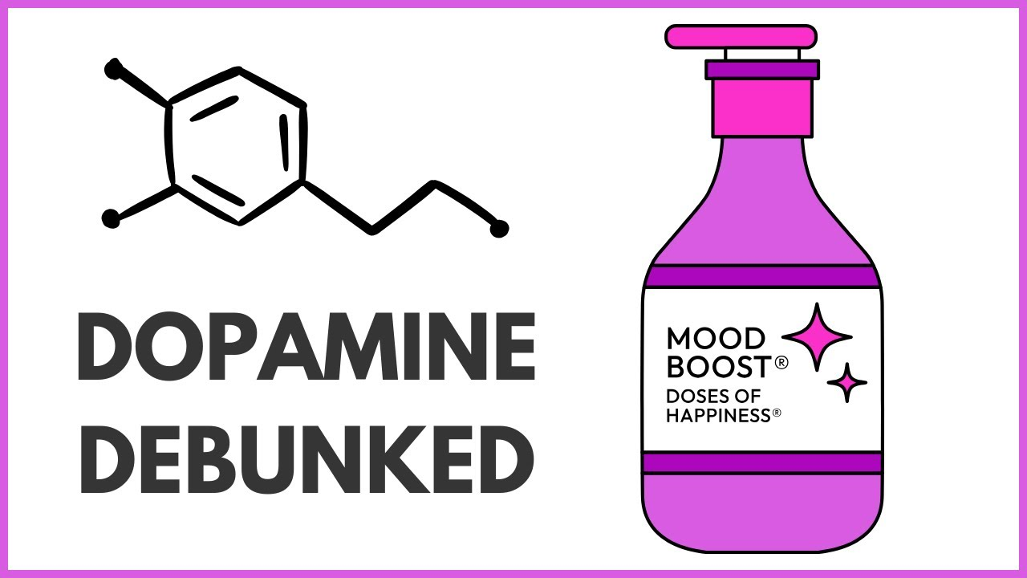
Implementing Reinforcement Learning in Brains
Beyond Simple Rewards
Dopamine ≠ “pleasure chemical”
Also signals novelty, salience, uncertainty
General teaching signal, not just reward
Notes:
t’s tempting to think of dopamine as a “pleasure chemical,” because its bursts often line up with rewarding events.
But the story is more complicated than that.
Dopamine neurons also respond to novelty.
An unexpected sound or visual stimulus can trigger a burst, even if it’s not rewarding.
They respond to salience — things that stand out as important or surprising, whether good or bad.
And they respond to uncertainty.
When the probability of reward is around 50%, dopamine neurons fire at an elevated, sustained rate throughout the waiting period.
That seems to reflect not pleasure, but the information value of an uncertain outcome.
So dopamine is not simply a “reward” or “pleasure” signal.
It is better understood as a general teaching signal, reporting when the world turns out differently than predicted — sometimes better, sometimes worse, sometimes simply unexpected.
This makes dopamine perfectly suited to drive reinforcement learning across many different contexts, not just in response to food or juice.

Slide 16
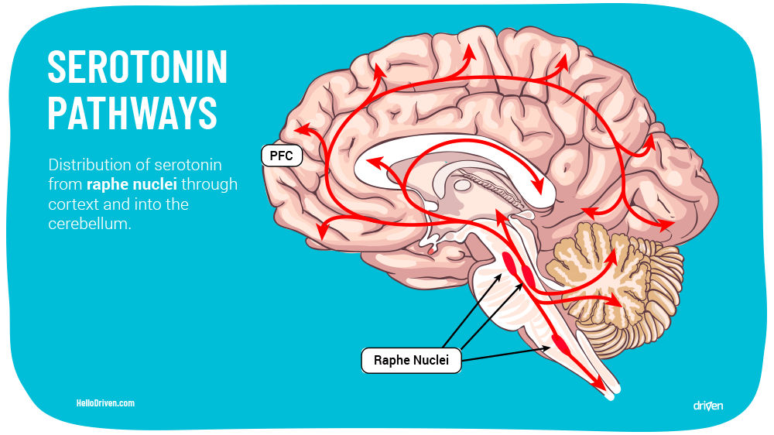
Implementing Reinforcement Learning in Brains
Other Neuromodulators
Serotonin → patience, inhibition, aversive learning
Norepinephrine → arousal, attention, surprise
Work with dopamine to balance behavior
Notes:
So far we’ve focused almost entirely on dopamine,
but it’s not the only neuromodulator involved in reinforcement learning and decision-making.
Two others play important complementary roles: serotonin and norepinephrine.
Serotonin is often associated with behavioral inhibition, patience, and avoidance.
It seems to play a role in learning about punishments or negative outcomes,
and in regulating how strongly immediate versus delayed rewards are valued.
High serotonin makes animals more likely to wait for larger, delayed rewards, and less likely to act impulsively.
This complements dopamine, which pushes toward approach and immediate pursuit.
Norepinephrine is closely tied to arousal, attention, and responding to unexpected events.
It is released strongly during surprise, novelty, or uncertainty.
You can think of it as a signal that helps the brain “pay attention” when something unexpected happens,
preparing circuits to update or reset.
Together with dopamine, these neuromodulators form a balanced system.
Dopamine pushes organisms to act on opportunities.
Serotonin tempers that with caution, patience, and avoidance when appropriate.
Norepinephrine keeps the system alert to surprises and ready to adapt.
So while dopamine is the star player for reinforcement learning,
serotonin and norepinephrine are important teammates,
shaping when to act, when to wait, and when to reorient.

Slide 17
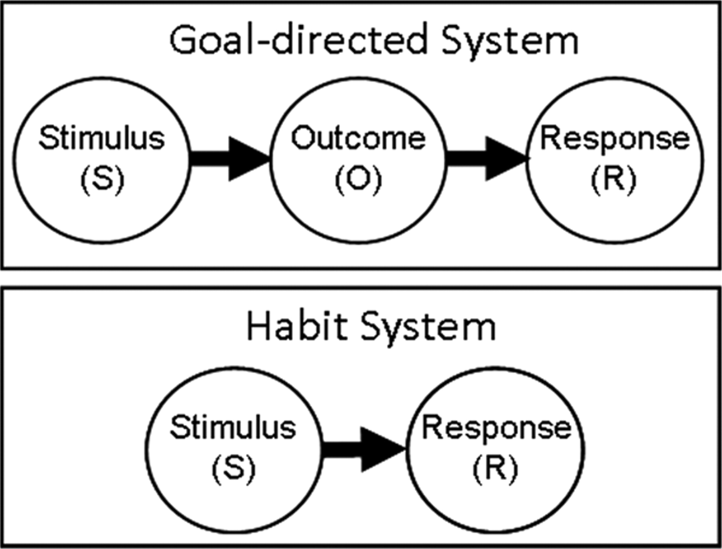
Implementing Reinforcement Learning in Brains
Habits vs Goal-Directed Systems
Dorsomedial striatum → goal-directed (devaluation-sensitive)
Dorsolateral striatum → habits (outcome-insensitive)
Practice shifts control from goals to habits
Notes:
Within the striatum, different regions support different kinds of control over behavior.
The dorsomedial striatum is linked to goal-directed actions.
Here, behavior is sensitive to the current value of the outcome.
If food is devalued — say the animal is sated, or the food is paired with illness
— actions to obtain it decrease.
This is flexible, outcome-sensitive control.
The dorsolateral striatum, by contrast, is linked to habits.
Here, actions are driven by stimulus–response associations
and are less sensitive to changes in outcome value.
Once a habit is established, the behavior tends to persist even if the reward is gone or reduced.
Experiments show that with training, control shifts from dorsomedial to dorsolateral striatum.
At first, actions are goal-directed, but with repetition they become habits.
This division of labor explains why some behaviors are flexible and deliberative,
while others are automatic and hard to change.
It also sets up an important real-world case where this shift plays a central role: addiction.

Slide 18
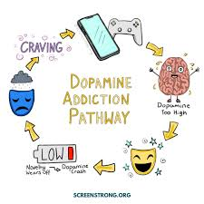
Implementing Reinforcement Learning in Brains
Addiction
Drugs hijack dopamine prediction error
Produce artificial bursts, regardless of outcome
Shift behavior from goal-directed to habitual
Notes:
Addiction provides a powerful example of what happens when the reinforcement learning system is hijacked.
Normally, dopamine bursts occur when outcomes are better than expected, and dips occur when outcomes are worse.
But addictive drugs such as cocaine, amphetamines, or opioids directly stimulate dopamine release in the striatum.
This means they produce a burst every time, regardless of whether the outcome was actually surprising or beneficial.
At first, drug-taking can be goal-directed: the person chooses to take the drug to get its effects.
But because the dopamine system is flooded artificially, the brain “learns”
that drug-related cues and actions are more valuable than they really are.
Over time, control shifts from the dorsomedial striatum to the dorsolateral striatum, from goal-directed to habitual.
That’s why drug-seeking behavior becomes compulsive, insensitive to outcomes, and so difficult to stop.
In short, addiction shows us what happens when the prediction error signal is corrupted.
The system that normally helps us learn adaptively instead locks in maladaptive habits.

Slide 19
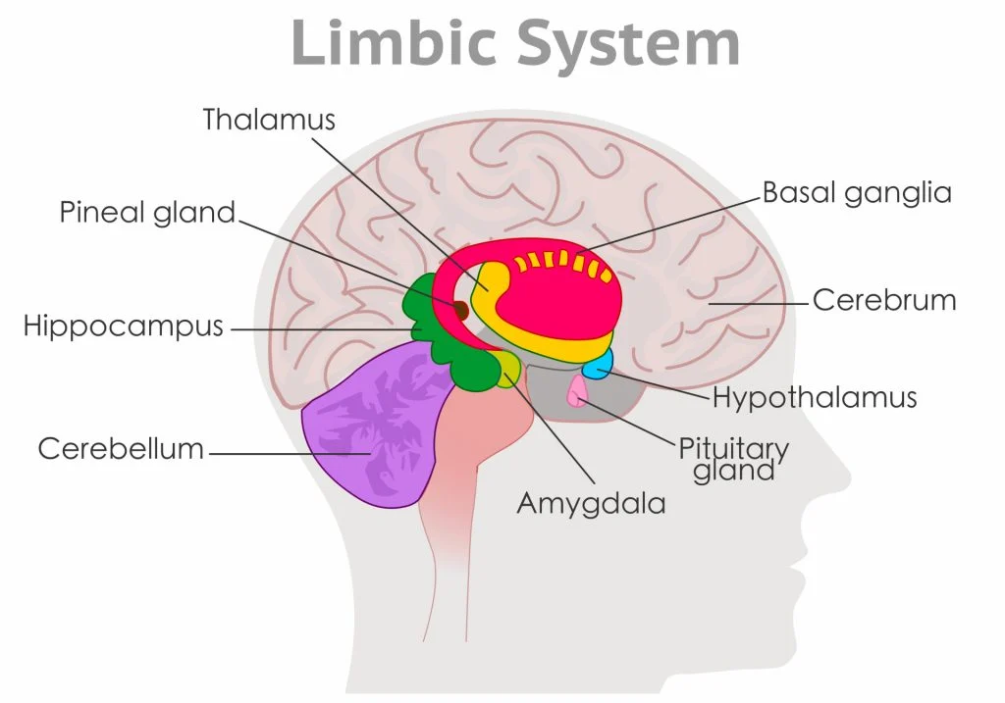
Implementing Reinforcement Learning in Brains
Other Circuits in RL
Prefrontal cortex → planning, model-based RL
Amygdala → valence, Pavlovian responses
Hippocampus → context, episodic memory
Notes:
So far we’ve emphasized the striatum and dopamine as the core of reinforcement learning in the brain.
But other circuits play important supporting roles.
The prefrontal cortex is essential for planning and for what we call model-based reinforcement learning.
It allows us to simulate different possible futures and choose actions,
based not just on past reinforcement, but on internal models of the world.
The amygdala is tightly linked to emotional valence and Pavlovian conditioning.
It helps assign value to cues and contexts, especially when threats or strong rewards are involved.
Through its connections to both the striatum and cortex, it shapes how affect influences decisions.
The hippocampus provides contextual and episodic information.
It allows reinforcement learning to be sensitive to where and when events occur.
For example, the same cue may predict reward in one environment but not in another.
The hippocampus enables the system to keep those associations separate.
Together, these circuits integrate with the basal ganglia and dopamine system,
giving reinforcement learning in the brain the flexibility to be sensitive to goals, emotions, and context.

Slide 20
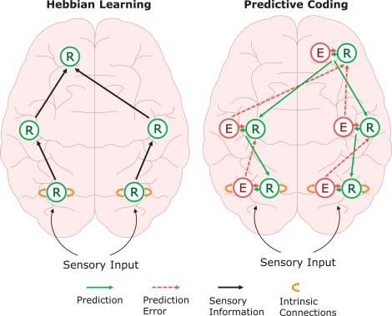
Implementing Reinforcement Learning in Brains
Putting It Together
Cortex ↔ basal ganglia ↔ thalamus loop
Dopamine: prediction error signal
Actor–critic roles mapped onto brain circuits
Notes:
We’ve now seen many different pieces of the story — dopamine firing patterns, basal ganglia pathways, habits and goal-directed systems, other neuromodulators and circuits.
Let’s put it all together.
The brain has a conserved loop connecting cortex, basal ganglia, and thalamus.
The cortex proposes actions and represents states.
The basal ganglia act as a gatekeeper, deciding which actions are released.
The thalamus feeds the results back up to the cortex.
Dopamine neurons broadcast a prediction error signal into this loop.
Bursts and dips of dopamine tune synapses in the striatum, reinforcing the actions that worked and discouraging those that didn’t.
The ventral striatum plays the role of the critic, learning to predict how good different states are.
The dorsal striatum plays the role of the actor, biasing choices toward actions that lead to better states.
Other neuromodulators like serotonin and norepinephrine, and other circuits like the amygdala, hippocampus, and prefrontal cortex, add layers of flexibility and context.
Altogether, this system implements reinforcement learning in the brain:
an elegant integration of circuits, chemicals, and computations that evolved to solve the problem of learning from trial and error.

Slide 21

Implementing Reinforcement Learning in Brains
Evidence & Speculation
Dopamine neurons = clear prediction error signals (Schultz, 1990s → today)
Basal ganglia loops conserved across vertebrates
Evolutionary “repurposing” story is plausible but inferred
Notes:
Now that we’ve told the story, let’s step back and ask: what parts are strongly supported,
and what parts are more speculative?
The strongest evidence comes from recordings of dopamine neurons in vertebrates.
Time and again, we see bursts for better-than-expected outcomes, baseline for expected outcomes,
and dips for worse-than-expected ones.
This matches the formal prediction error models in remarkable detail.
We also know that basal ganglia loops are deeply conserved across vertebrates.
Fish, amphibians, birds, and mammals all share the same core organization,
suggesting this structure is ancient and fundamental.
The more speculative part is the evolutionary repurposing story.
We know dopamine is ancient and present in invertebrates, where it shapes arousal, locomotion, and motivation.
We know that in vertebrates, dopamine is plugged into basal ganglia loops and functions as a teaching signal.
It’s reasonable to infer that a repurposing occurred
— that dopamine’s role shifted from general modulation to precise prediction error signaling.
But the exact steps in that evolutionary transition are lost to us.
We can’t reconstruct how or when the circuits were rewired.
So we should treat this as a plausible, evidence-informed hypothesis, not a fully proven historical fact.
This distinction is important: in cognitive science and neuroscience,
some parts of the story are data, others are inferences, and it’s valuable to make that clear.

Slide 22
Implementing Reinforcement Learning in Brains
What We Learned
Dopamine: prediction error → teaching signal
Basal ganglia: action gating + RL engine
What’s Next
How brains and machines recognize complex patterns
Notes:
Today we’ve seen how reinforcement learning is implemented in the brain.
We traced the evolutionary story of dopamine:
from an ancient neuromodulator tuning arousal and motivation,
to a precise prediction error signal in vertebrates.
We saw how basal ganglia loops serve as action gates,
and how dopamine bursts and dips shape synaptic plasticity in these circuits.
We mapped these onto the actor–critic model,
showing how the brain reinforces successful actions and suppresses unsuccessful ones.
And we broadened the view: habits, addiction, other neuromodulators,
and circuits that all feed into this powerful system.
The big picture is that reinforcement learning in the brain is not just a metaphor.
It’s an actual biological mechanism, implemented through conserved circuits and neuromodulators.
Next time, we shift focus from learning what to do to recognizing what we see and experience.
We’ll ask:
how do brains and machines represent complex patterns?
Why is generalization so hard?
What’s the tradeoff between memorization and abstraction?
And how do artificial neural networks — and real neural circuits — solve these challenges?
In other words, we move from reinforcement learning
— choosing actions based on outcomes
— to pattern recognition — interpreting the world in ways that make learning and action possible.

